Slide 1
Crisis services and diversion: HOW state AND local partnerships CAN MAKE A DIFFERENCE
Bazelon Center for Mental Health Law

Slide 2
DISCLAIMER
This webinar was developed [in part] under contract number HHSS283201200021I/HHS28342003T from the Substance Abuse and Mental Health Services Administration (SAMHSA), U.S. Department of Health and Human Services (HHS). The views, policies and opinions expressed are those of the authors and do not necessarily reflect those of SAMHSA or HHS.

Slide 3
SPEAKERS
Colleen Clark-Bernhardt: Manager, Policy and Practice Innovation Division, Dane County (WI) Board of Supervisors; Coordinator. Dane County Criminal Justice Council (she/her/hers)
Brad S. Munger: Program and Policy Analyst-Advanced, Wisconsin Department of Health Services (he/him/his)
Jennifer Lav: Senior Attorney, National Health Law Program (she/her/hers)
Brian McGregor, Ph.D.: Owner, McGregor Research & Consulting, LLC; Adjunct Clinical Assistant Professor, Department of Psychiatry & Behavioral Science, Morehouse School of Medicine (he/him/his)

Slide 4
LEARNING OBJECTIVES
Identify what local governments and community stakeholders are doing to divert people with behavioral health issues from law enforcement and incarceration.
Learn what state behavioral health and Medicaid agencies can do to support local community diversion efforts.
Understand federal resources available to support state and local partnerships for diversion.
Consider how to incorporate equity concerns into behavioral health diversion efforts.

Slide 5
WHAT IS A CRISIS?
There are many definitions.
A mental health crisis is any situation in which a person’s behavior puts them at risk of hurting themselves or others and/or prevents them from being able to care for themselves or function effectively in the community.
                National Alliance on Mental Illness (NAMI)

Slide 6
WHAT IS A CRISIS?
A broader definition:
A situation caused by an individual's apparent mental disorder which results in a high level of stress or anxiety for the individual, persons providing care for the individual or the public which cannot be resolved by the available coping methods of the individual or by the efforts of those providing ordinary care or support for the individual.
              Wisc. Adm. Code. DHS 34.02(5)

Slide 7
WHAT IS A CRISIS?
A crisis might follow or be accompanied by:
  Intense feelings of emotional distress (anxiety, depression, anger, panic, hopelessness);
  Obvious changes in functioning (neglect of personal hygiene, unusual behavior);
  Catastrophic life events (disruptions in personal relationships, support systems or living arrangements, loss of autonomy or parental rights, victimization or natural disasters).
  A crisis may (but need not) involve imminent danger to self or others.
                Substance Abuse and Mental Health Services Administration (SAMHSA)

Slide 8
WHAT IS A CRISIS?
Sometimes what appears to be a crisis is not a crisis.
Sometimes what a person and/or family members and friends think is not a crisis really is a crisis.

Slide 9
Mobile Crisis Services
Services provided where the person is in the community – not in hospital or facility setting;
Provided by a multidisciplinary team, including a licensed and/or credentialed clinician capable of assessing needs;
Connect individuals to other levels of care, to providers, and other resources.
Incorporate peers;
Generally respond without law enforcement;
Be available 24/7/365 and respond in a timely manner;
Trained in de-escalation and resolution (e.g. harm reduction and trauma-informed care).
Resource: SAMHSA, National Guidelines for Behavioral Health Crisis Care – A Best Practices Toolkit
Notes:
Note that range of staffing models exist, and can be individualized for different communities and to target different populations, and could have different constellation of members-- Example: CAHOOTS model: one clinician, one EMT, Mobile crisis for SUD .

Slide 10
DEFINING EQUITY
Equity is just and fair inclusion into a society in which all, including all racial and ethnic groups, can participate, prosper, and reach their full potential. Equity gives all people a just and fair shot in life despite historic patterns of racial and economic exclusion.
                www.policylink.org

Slide 11


Local Perspectives
Moving effective alternatives forward
Colleen Clark Bernhardt
Criminal Justice Council
Dane County, WI cjc.countyofdane.com

Slide 12

Criminal Justice Council (CJC)
Executive level collaboration:
Ongoing forum for collaboration and coordinated leadership
Implement Data driven criminal justice policy and practice
Monitor progress
Provide oversight

Slide 13
Using the Sequential Intercept Model as a launchpad for better systems
https://www.youtube.com/watch?v=yn9Ao2edpL8&t=7s
Representatives from Police, Fire, EMS, 911, Human Services, Criminal Justice Council, Behavioral Health experts, Housing Solutions, Recovery Houses, Sheriff, Medical Provider for Jail, and more

Slide 14


Slide 15

Immediate Action Steps
Develop formal subcommittee focused on the intersection of behavioral health and criminal justice
DATA TEAM
FAMILIAR FACES (new Booking Alert)
EARLY LEARNING TRIAGE CENTERS AND MOBILE CRISIS UNITS

Slide 16
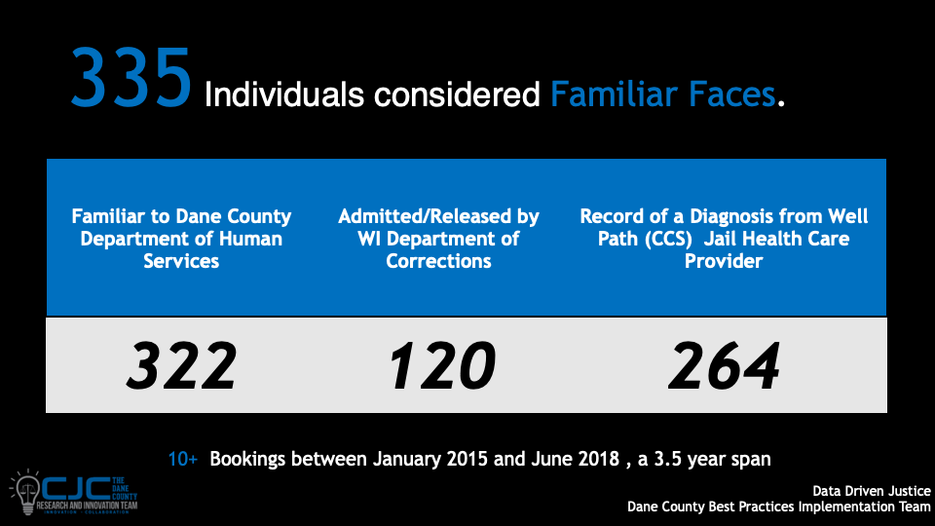

Slide 17
Piloting new alternatives
City of Madison
CARES- New initiative designed to provide alternative emergency response for individuals in crisis (Community Alternative Response Emergency Services)
Dane County
Crisis Triage Center
County Exec and County Board fund 10M in 2021 budget

Slide 18
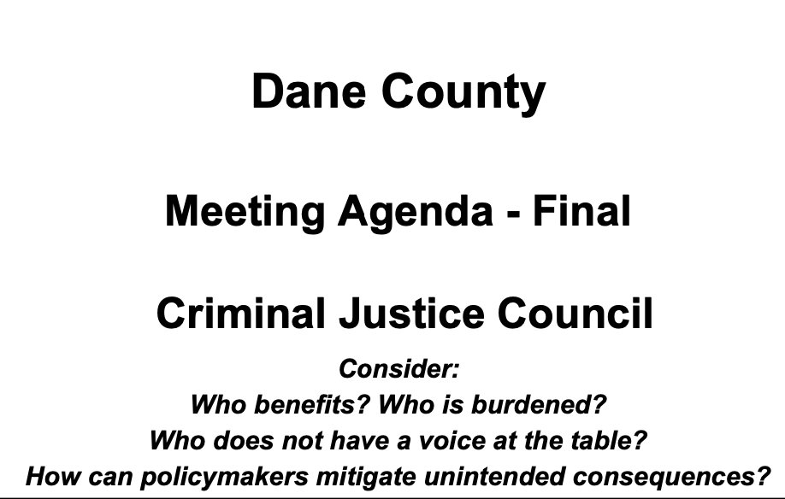
Integrating Equity into operational fabric
Agenda questions
RFP community engagement intentionality
Annual presentations at budget time by each department
Equity Workplans published annually by the Office for Equity and Inclusion

Slide 19
Data. Equity. Justice.
Executive level decision makers
Collaboration between criminal justice and behavioral health
County, City and Community Leaders
Learn together with national expert guidance
Focus on long term goals and greater purpose
Build collaborative partnerships

Slide 20

Questions?
Colleen Clark-Bernhardt
Clark.colleen@countyofdane.com

Slide 21
Crisis Services in Wisconsin
Brad Munger
Program and Policy Analyst-Advanced

Slide 22
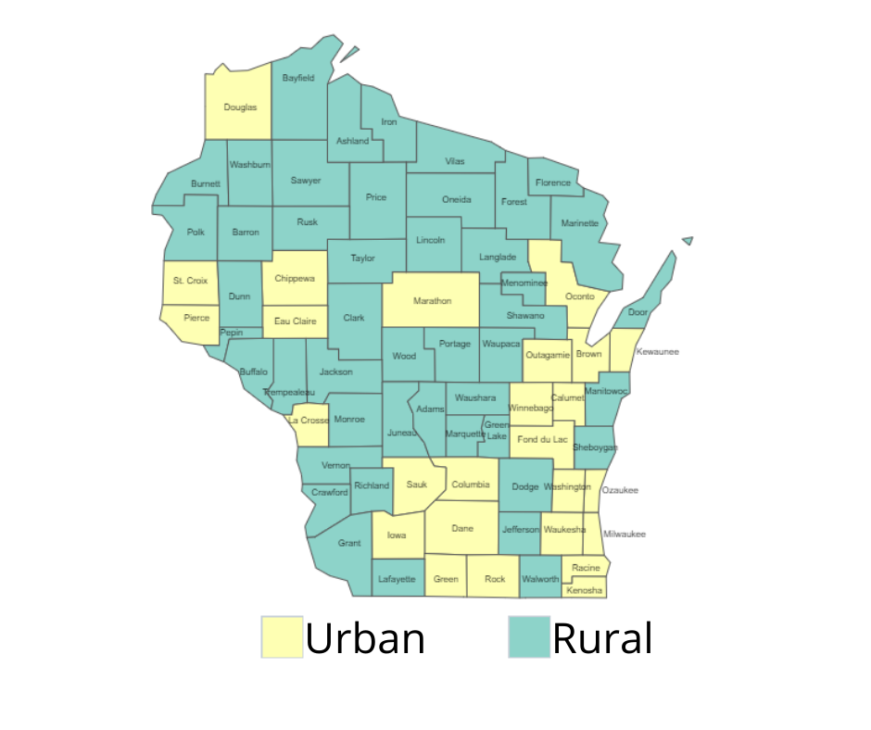
Wisconsin
Population: 5,893,718 in 2020 – 3.6 percent growth since 2010
Home rule state, county-based system
72 counties: 46 rural,
26 urban
Largest urban areas:
  Milwaukee County 939,489
  Dane County (State Capital, Madison) 561,504
  Waukesha (adjacent to Milwaukee) 406,978
  Brown County (Green Bay) 268,740

Slide 23

Wisconsin
Two state institutes for mental disease
State IMD
State IMD

Slide 24
Race and ethnicity

Slide 25
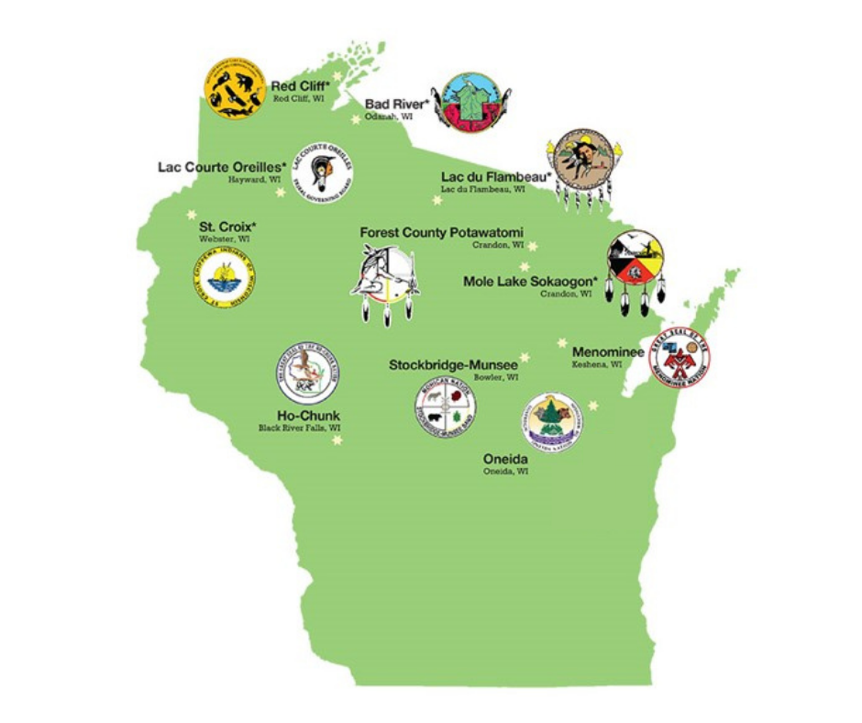
Native American tribes
11 federally recognized Native American tribes in Wisconsin
Notes:
Bad River Band of Lake Superior Chippewa
Forest County Potawatomi
Ho-Chunk Nation
Lac Courte Oreilles Band of Lake Superior Chippewa
Lac du Flambeau Band of Lake Superior Chippewa
Menominee Indian Tribe of Wisconsin
Oneida Nation of Wisconsin
Red Cliff Band of Lake Superior Chippewa
St. Croix Band of Chippewa Indians of Wisconsin
Sokaogon Chippewa Community
Stockbridge-unsee Band of Mohican Indians

Slide 26
Crisis administrative rule
Emergency Mental Health Services Programs
(Wis. Admin. Code ch. DHS 34)
Codified in 1996
Established fee-for-service (FFS) Medicaid reimbursement

Slide 27
Minimum crisis service requirements
24/7 phone service
8 hours/7-day per week mobile crisis services
8 hours/5-day per week walk-in crisis services
24/7 short-term voluntary and involuntary hospital
24/7 linkage and coordination
Services for children, adolescents, and their families

Slide 28
America Recovery Plan Act mobile crisis intervention services team
Planning grant
Mobile crisis intervention services
  Available 24/7/365
  Training requirements, including trauma-informed care
  Partnerships with community-based providers.
  At least one behavioral health professional on team able to conduct an assessment
Can enable 85% federal Medicaid match for up to three years

Slide 29
Reimbursement for crisis
Under supervision of licensed mental health professional
Medicaid fee-for-service
  Based on qualifications of rendering provider
  Psychiatrist to paraprofessional
Federal Medicaid with local county match
  Local match capped in 2020 with regional approach
  DCTS Action Memo 2020-02
Notes:
DHS will calculate each county agency’s contribution cap by taking 75% of the average allowable crisis intervention costs for calendar years 2016, 2017, and 2018. This will be the county contribution maintenance of effort for calendar year 2020 and thereafter.

Slide 30
Fee-for-service
Medicaid maximum fee schedule for crisis
Procedure Code | Rendering Provider | Modifiers | Rate
S9484 | Psychiatrist | UA | $110.46
 | Advanced Practice Nurse Prescriber | UB | $110.46
 | Doctoral Level | HP | $82.19
 | Masters Level | HO | $66.29
 | Bachelors Level | HN | $66.29
 | Paraprofessional | U7 | $35.36
S9485 Stabilization | Per diem |  | $104.04

Slide 31
Commercial insurers
Wisconsin is not a Medicaid expansion state.
Required reimbursement by commercial insurers is regulated by Office of the Commissioner of Insurance. Wis. Admin. Code § INS 3.37(3)(g)

Slide 32
County and contracted crisis programs
Only counties can be certified crisis programs
DHS Division of Quality Assurance certifies and surveys programs
Many counties contract with private vendors for one or more services—often a call center:
  Journey Mental Health Center (Dane County)
  Impact 211 (Milwaukee and Waukesha counties)
  Northwest Connections
  Family Services of Northeast Wisconsin

Slide 33
Resources and studies
Crisis services webpage
Wisconsin Mental Health and Substance Use Needs Assessment 2019
Crisis Intervention Services Survey (summary)
Differences in Crisis Services and Psychiatric Hospitalizations across Race and Ethnicity
Toolkit for Improving Crisis Intervention and Emergency Detention Services

Slide 34
Training and networking
Crisis Intervention Network (monthly meetings)
Behavioral Health Training Partnership
Crisis Intervention Team (CIT) Training Wisconsin
Wisconsin Dementia Care Project Learning Center
Crisis Intervention Conference
Mental Health and Substance Use Recovery Conference
Wisconsin Public Psychiatry Network Teleconference (twice monthly webinars)

Slide 35
Crisis services workgroup
Partnership formed in early 2019 between counties and DHS
Focus: Improve the overall crisis infrastructure using Crisis Now framework
Workgroups formed in January 2021:
    Diversity, equity, and inclusion
    Law enforcement and emergency detention
    Medical clearance (Wisconsin SMART evaluation)
    Substance use disorder
    Telehealth

Slide 36
Diversity, equity, and inclusion
Non-white Wisconsinites have disproportionately high involvement with crisis programs and disproportionally low involvement in non-crisis mental health programs.
Focus is on implementation of the National Standards for Culturally and Linguistically Appropriate Services in crisis programs in order to reduce disparity.
Family Services of Northeast Wisconsin, which provides crisis services to 16 counties, launched a pilot program providing diversity, equity, and inclusion specific training and ongoing consultation to crisis staff.
Family Services added diversity, equity, and inclusion materials to Crisis staff orientation, ongoing training, and to yearly staff evaluations.

Slide 37
Law enforcement and emergency detention
The focus is on structuring crisis services so law enforcement is not a primary responder during crisis.
Promote earlier access to effective behavioral health care
Crisis services ideally rendered before law enforcement is involved
If law enforcement is involved, co-responder and Crisis Intervention Team (CIT) are preferred
Minimize the use of emergency departments
Use of stabilization resources and diversion (residential stabilization)
When transportation is required minimize reliance on law enforcement

Slide 38
Law enforcement and emergency detention pilot projects
Rapid cycle pilot projects
Building peer support involvement
Training to emergency medical services
Improving crisis visibility and coordination with law enforcement
Connecting jail residents to mainstream behavioral health services
Embedding crisis responder in sheriff’s department

Slide 39
Thank you!
Brad Munger
Program and Policy Analyst-Advanced
brad.munger@dhs.wisconsin.gov
608-292-0027

Slide 40
Mobile Crisis Services
Jennifer Lav, Senior Attorney

Slide 41
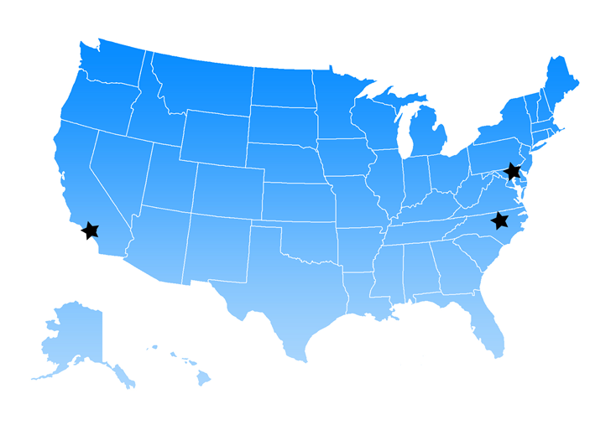
About the National Health Law Program
National non-profit law firm committed to improving health care access, equity, and quality for underserved individuals and families
State & Local Partners:
  Disability rights advocates – 50 states + DC
  Poverty & legal aid advocates – 50 states + DC
National Partners
Offices: CA, DC, NC
www.healthlaw.org
Follow us on Twitter @NHeLP_org
Like us on Facebook @NHeLProgram

Slide 42
NHeLP’s Equity Stance
Health equity is achieved when a person’s characteristics and circumstances –– including race and ethnicity, sex, gender identity, sexual orientation, age, income, class, disability, health, immigration status, nationality, religious beliefs, language proficiency, or geographic location –– do not predict their health outcomes.
https://healthlaw.org/equity-stance/

Slide 43
Mobile Crisis Services
Services provided where the person is in the community – not in hospital or facility setting;
Provided by a multidisciplinary team, including a licensed and/or credentialed clinician capable of assessing needs;
Connect individuals to other levels of care, to providers, and other resources.
Incorporate peers;
Generally respond without law enforcement;
Be available 24/7/365 and respond in a timely manner;
Trained in de-escalation and resolution (e.g. harm reduction and trauma-informed care).
Resource: SAMHSA, National Guidelines for Behavioral Health Crisis Care – A Best Practices Toolkit
Notes:
Note that range of staffing models exist, and can be individualized for different communities and to target different populations, and could have different constellation of members-- Example: CAHOOTS model: one clinician, one EMT, Mobile crisis for SUD .

Slide 44
Mobile Crisis Is One Part of the Crisis Services System
1. 24/7 call center
      Staffed with clinicians and peers
      “Care traffic control” – linking to the right resource
2. Mobile crisis teams
3. Crisis stabilization settings
      For example, community crisis apartments

Slide 45
Effectiveness
Studies show mobile crisis teams reduce law enforcement contact and incarceration, for children and adults.
  Studies show mobile crisis teams prevent hospitalization
  Adults who have contact with mobile crisis teams are less likely to be admitted to the hospital.
  Mobile crisis services reduce youth ED visits.
  Mobile crisis response is generally less costly than hospitalization.
  Both people with disabilities and law enforcement officers prefer a mobile crisis response.

Slide 46
New Medicaid Funds for Mobile Crisis Services
Under American Rescue Plan Act (ARPA), states may apply for and receive an 85% federal Medicaid match for qualified mobile crisis services.
  H.R. 1319, Public Law No. 117-2, Section 9813 (became law 3/11/2021)
  Centers for Medicare & Medicaid Guidance, SHO #21-008 (December 28, 2021)
Notes:
Medicaid is the single largest payer for behavioral health services—more than private insurance, more than Medicare, more than the state block grants.
Plays a pivotal roll in shaping the types of services that are available and the influencing practice models.

Slide 47
For every dollar spent on Medicaid
Normal Breakdown
Qualified Mobile Crisis Services
Federal share:
56 ₵
State Share:
44 ₵
Federal share:
85 ₵
State Share:
15 ₵
States may receive the enhanced Medicaid match for up 12 fiscal quarters (3 years) during a 5 year period, starting April 1, 2022.
Notes:
Explain how Medicaid normally works—state/federal partnership – where states pay a part of every dollar spent on Medicaid services, and federal government pays the other portion.

Slide 48
Requirements for Increased Medicaid Funding
1) Provided to Medicaid-eligible individuals:
  Outside of hospital or other facility;
  Who are experiencing a mental health or substance use disorder crisis.
2) By a Multidisciplinary mobile crisis team that:
  Includes at least one BH health care professional who can conduct an assessment (including nurses, social workers, peer support professionals);
  Is trained in de-escalation, trauma-informed care, and harm reduction; and
  Can respond in a timely manner to provide:
    Screening and assessment;
    Stabilization and de-escalation;
    Coordination with and referrals to other services; and
  Maintains relationships with relevant community partners.
3) Is available 24/7, 365 days a year.
Notes:
Services must be accessible to people with communications disabilities
State needs to set timeliness standards
MOE Requirement—States cannot get this new funding and cut their current mobile crisis services, if they already provide the service.

Slide 49
State Design Choices for Enhanced Match
For adults, mobile crisis services can be geographically targeted, not statewide.
States may apply for funding through any of the following:
  State plan amendment (SPA; including 1915(i))
  1915(b) waiver (for Medicaid managed care programs)
  1915(c) waiver (for home- and community-based services)
  1115 demonstration project

Slide 50
Mobile Response and Stabilization Services for Children and Youth
Under Medicaid’s Early and Periodic Screening, Diagnostic, and Treatment (ESPDT) mandate, children under 21 must get whatever services they need to correct or ameliorate a medical condition, including mobile crisis services.
Cannot be geographically limited.
The ARPA 85% Medicaid match is available for mobile crisis services for children and youth, but nothing in APRA changes the EPSDT mandate.
Specialized mobile crisis teams for youth can work with families, schools, and other providers to help plan for crises, and should be paired with stabilization services to help children and families post-crises.
Resource: National Health Law Program, Children’s Behavioral Health Mobile Response and Stabilization Services (Feb. 1, 2022).

Slide 51
Linkages to Community-Based Services
Case management
Intensive case management
Assertive Community Treatment (ACT)
Housing Services/Permanent Supported Housing
Supported Employment
Peer Services
“Wraparound” Services for Children and Youth
Resource: Bazelon Center, Diversion to What? Evidence-Based Mental Health Services That Prevent Needless Incarceration (Sept. 2019)

Slide 52
Other Federal Financing
5% of SAMHSA Mental Health Block Grant (MHBG) funds must be spent on crisis services
Certified Community Behavioral Health Clinics (CCBHCs)
Notes:
Other sources of funding– CCBHCs are required to either provide directly or contract for mobile crisis services. CCBHCs now exist in 33 states—though CCBHCs are not statewide. The CCBHC Certification Criteria, which all CCBHCs must adhere to, require provision of crisis management services that are available and accessible 24-hours a day and delivered within three hours.
Block grant is a small amount, compared to Medicaid.

Slide 53
Questions?
Jennifer Lav
Senior Attorney
National Health Law Program
lav@healthlaw.org

Slide 54
Thank you!

